Slide 1





Stress and
Health
Stress and
Health

Slide 2

Stress and Stressors
9.1 How do psychologists define stress?
Stress - physical, emotional, cognitive, and behavioral responses to threatening or challenging events
Stressor – cause of stress reaction
Distress - effect of undesirable stressors
Eustress - effect of positive events
Notes:
Stress - the term used to describe the physical, emotional, cognitive, and behavioral responses to events that are appraised as threatening or challenging.
Stressors - events that cause a stress reaction.
Distress - the effect of unpleasant and undesirable stressors.
Eustress - the effect of positive events, or the optimal amount of stress that people need to promote health and well-being.

Slide 3

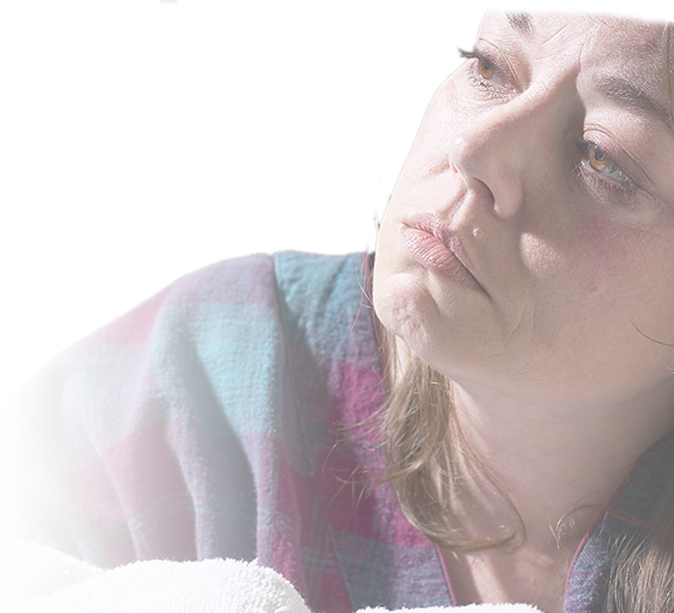




Environmental Stressors
9.2 What kinds of external events can cause stress?
Catastrophe - unpredictable, large-scale event
  extreme adaptation, adjustment, feelings of threat
Acute stress disorder - anxiety, nightmares, poor sleep, reliving the event, concentration problems
  Post-Traumatic Stress Disorder (PTSD) – over 30 days of symptoms
Notes:
Catastrophe - an unpredictable, large-scale event that creates a tremendous need to adapt and adjust as well as overwhelming feelings of threat.
Acute stress disorder - a disorder resulting from exposure to a major stressor, with symptoms of anxiety, nightmares, poor sleep, reliving the event, and concentration problems
Post traumatic stress disorder (PTSD) – when above mentioned symptoms last for more than 30 days, the disorder is called PTSD.

Slide 4



Major Life Changes
TABLE 9.1 College Undergraduate Stress Scale (CUSS)
EVENT
RATING
Being raped
Finding out that you are HIV-positive
Death of a close friend
Contracting a sexually transmitted disease (other than AIDS)
Concerns about being pregnant
Finals week
Oversleeping for an exam
Flunking a class
Having a boyfriend or girlfriend cheat on you
Financial difficulties
Writing a major term paper
Being caught cheating on a test
Two exams in one day
Getting married
Difficulties with parents
Talking in front of a class
Difficulties with a roommate
Job changes (applying, new job, work hassles)
A class you hate
Confrontations with professors
Maintaining a steady dating relationship
Commuting to campus or work, or both
Peer pressures
Being away from home for the first time
Getting straight A’s
Fraternity or sorority rush
Falling asleep in class
100
100
97
94
92
90
89
89
85
84
83
83
80
76
73
72
66
65
62
60
55
54
53
53
51
47
40
Source: Adapted from Renner and Mackin (1998)
Notes:
College Undergraduate Stress Scale (CUSS) - assessment that measures the amount of stress in a college student’s life over a one-year period resulting from major life events.

Slide 5

Hassles
Hassles – frustrations, delays, irritations, minor disagreements, etc.
  residual “ripples” from stressors
Notes:
Hassles - the daily annoyances of everyday life.
Experiencing major changes in one’s life is like throwing a rock into a pond: There will be a big splash, but the rock itself is gone. What is left behind are all the ripples in the water that came from the impact of the rock. Those “ripples” are the hassles that arise from the big event.
Children in the preschool age range find teasing by their peers to be the biggest daily hassle they experience. This boy is obviously upset by the teasing of the other children, who are making fun of his glasses. What other hassles might a child in this age range experience?
In one study, researchers found that among 261 participants who experienced headaches, scores on a scale measuring the number and severity of daily hassles were significantly better predictors of headaches than were scores on a life events scale. The researchers also found that it was not so much the number of daily hassles that predicted headaches but rather the perceived severity of the hassles.

Slide 6

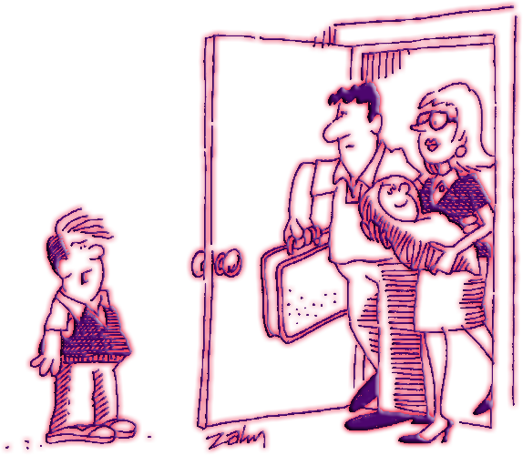




Everyday Sources of Stress
9.3 What are some psychological factors in stress?
Pressure - urgent demands or expectations from outside source
Uncontrollability - degree of control over event or situation
Frustration – desired goal or fulfillment of perceived need blocked
“I suppose this puts my new bike
On the back burner?”
Notes:
Pressure - the psychological experience produced by urgent demands or expectations for a person’s behavior that come from an outside source.
Pressure - When there are urgent demands or expectations for a person’s behavior coming from an outside source.
Uncontrollability - the degree of control that the person has over a particular event or situation. The less control a person has, the greater the degree of stress.
Frustration - the psychological experience produced by the blocking of a desired goal or fulfillment of a perceived need.
Cartoon: ©The New Yorker Collection 2005 Bob Zahn from cartoonbank.com. All Rights Reserved.

Slide 7




Everyday Sources of Stress
Aggression – actions meant to harm or destroy; often stems from frustration
  Displaced aggression – frustration focused on less threatening/available target
  Escape or withdrawal - leaving the presence of a stressor, literally or psychologically
Notes:
Aggression – actions meant to harm or destroy; often stems from frustration
Displaced aggression – taking out one’s frustrations on some less threatening or more available target, a form of displacement.
Escape or withdrawal - leaving the presence of a stressor, either literally or by a psychological withdrawal into fantasy, drug abuse, or apathy.

Slide 8

Suicide in America
1980 to 1996 – suicide (10 to 14 years of age) rates doubled
2004 – third leading cause of death for adolescents
Rates increase with age (elderly highest)
Men four times as likely to complete suicide attempt (as compared to women)
American Indian/Alaskan natives particularly at risk
Notes:
Here are the facts:
• In 1996, among teenagers and young adults suicide took more lives than cancer, heart disease, AIDS, birth defects, strokes, pneumonia, the flu, and chronic lung diseases combined.
• More people die from suicide than from homicide, and the most common method of committing suicide is with a firearm.
• From 1980 to 1996 the rate of suicides among children 10 to 14 years of age increased by 100 percent. Suicide is the third leading cause of death among adolescents and in 2004 was the eleventh leading cause of death for all ages.
• Rates of suicide increase with age and are highest for those over 65.
• Women are about three times more likely than men to attempt suicide, but men are nearly four times more likely to complete the attempt.
• Suicide rates in both completed and attempted suicides among adolescents vary according to ethnicity as well as gender, with suicide deaths highest among male American Indian/Alaska natives, and suicide attempts highest among female American Indian/Alaska natives. The lowest rates of deaths were African American females, and the lowest rates of attempts were among African American and white males.
• Among American Indian/Alaska natives, for young adults suicide is the second leading cause of death (CDC, 2005).

Slide 9

Signs of Impending Suicide
Feelings of emptiness
Lack of energy
Inability to feel pleasure
Irritability
Sleeping problems
Eating more or less than usual
Notes:
Signs of Impending Suicide
•feelings of hopelessness or emptiness
• lack of energy or fatigue
• anhedonia, or the inability to feel pleasure or enjoyment
• irritability
• sleeping problems, either too much sleep or too little
• eating more or less than usual
• physical symptoms that persist, such as headaches, stomachaches, or pain
People who are depressed and intend to commit suicide usually do talk about it, and this communication should always be taken seriously.

