Slide 1
Obsessive-Compulsive and Related Disorders (Module 9)

Slide 2
Learning Objectives
Describe how obsessive-compulsive disorders present.
Describe the epidemiology of obsessive-compulsive disorders.
Describe comorbidity in relation to obsessive-compulsive disorders.
Describe the etiology of obsessive-compulsive disorders.
Describe treatment options for obsessive-compulsive disorders.

Slide 3
Obsessive-Compulsive Disorder (OCD)
OCD presents with obsessions and/or compulsions that significantly impair one’s functioning.
Obsessions → intrusive, time-consuming, unwanted, repetitive, and persistent thoughts, urges, or images (e.g., contamination, errors of uncertainty, thoughts of physical harm or violence, orderliness)
Compulsions → repetitive behaviors or mental acts that an individual performs in order to alleviate the anxiety caused by an obsession (e.g., checking, counting, hand-washing, symmetry, repeating specific words)
High comorbidity (76%) with other anxiety disorders.
Also, 41% will be diagnosed with a major depressive episode.
Childhood triad: OCD, tic disorder, ADHD
Those with schizophrenia, bipolar disorder, and Tourette’s have a higher chance of having OCD.
Prevalence in the United States and worldwide is 1.2%.
More common in women than men except in childhood; genders tend to differ in how their OCD presents

Slide 4
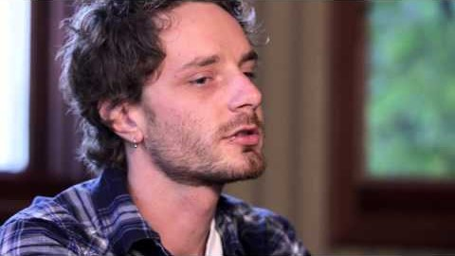
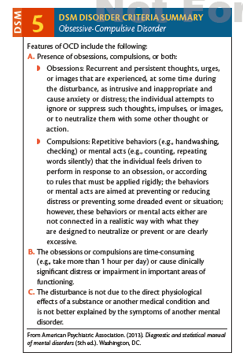
OCD: In Action, DSM-5 Criteria
In the video, what obsession(s) and compulsion(s) does the man report?
Notes:
https://www.youtube.com/watch?v=_GT-qKTp9L0

Slide 5
Treatments
1. Exposure and Response Prevention
First developed by Victor Meyer in 1966
Individuals are repeatedly exposed to their obsession while simultaneously being prevented from engaging in their compulsive behaviors.
Involves teaching the patient relaxation techniques
Works with a hierarchy of obsessions
86% response rate
Biggest obstacle is committing to treatment – exposure is stressful!
2. Psychopharmacology
Only a temporary fix
60% experienced improvement, but symptoms quickly returned after discontinuation of medicine.
There’s no added benefit of a combination treatment.

Slide 6
Body Dysmorphic Disorder (BDD)
Obsessions focus on perceived flaws or defects in one’s physical appearance that are not visible to others (e.g., skin, hair, nose) – e.g., muscle dysmorphia
Compulsions involve comparing one’s body to others’, repeatedly looking at one’s reflection, excessive grooming
Individuals spend an average of 3 to 8 hours a day on their compulsions which causes significant impairment in functioning.
Prevalence rate in the United States is 2.4% although the worldwide rate is 1.7-1.8%.
Women are more likely to be diagnosed with BDD than men; gender-specific presentations
Comorbidity
Mostly comorbid with major depressive disorders
Somewhat comorbid with social anxiety, OCD, substance-related disorders

Slide 7
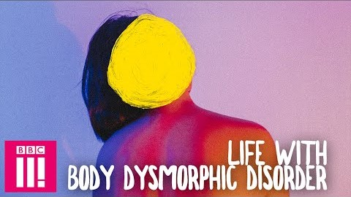
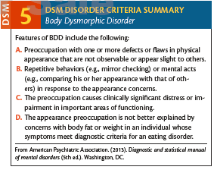
BDD: In Action, DSM-5 Criteria
Why do you think the first doctor from the video missed the patient’s final diagnosis of BDD?
Notes:
https://www.youtube.com/watch?time_continue=1&v=5de6dP1bXXE

Slide 8
Treatments
Same as OCD
Difficult, because only 9% of participants experienced full remissions at their 1-year follow-up
21% reported full remission at the same follow-up
Another study showed 76% had full remission over an 8-year period
Plastic surgery and medical treatments
76.4% reported engaging in this in some way
Individuals are rarely satisfied afterwards

Slide 9
Hoarding
Persistent over-accumulation of possessions without ever discarding possessions, regardless of their value or sentiment
Possessions are often kept in living spaces, leaving these spaces unusable
Cleaning causes significant distress
Cognitively, individuals fear losing important information and/or being wasteful.
Impacts daily functioning
Prevalence (although unstudied) is about 2-6%
More common in males than females according to some studies, but vice versa in other studies; females seek treatment more than males
Older individuals (ages 55-94) are 3 times more likely to be diagnosed than younger individuals
High comorbidity with mood and anxiety disorders (75%) while about 20% also have OCD

Slide 10
Treatments
CBT (discussions about the individual’s motives for keeping items and their fears about cleaning)
Many individuals prematurely end treatment.

Slide 11
Etiology
Biological
Hereditary transmission
Twin studies
Stronger heritability association for obsessions than for compulsions
Earlier onset correlates with more first-degree relatives diagnosed with OCD
Neurotransmitter deficits (serotonin and possibly glutamate, GABA, and dopamine)
Abnormal functioning in brain structures (orbitofrontal cortex, caudate nuclei, and thalamus)
Cognitive
Over-interpretation of potential negative outcomes of events
Disconfirmatory bias (causes the individual to seek out evidence that proves they failed to perform the ritual or compensatory correctly)
Can’t trust themselves and their instincts
Behavioral (classical conditioning)

