Slide 1
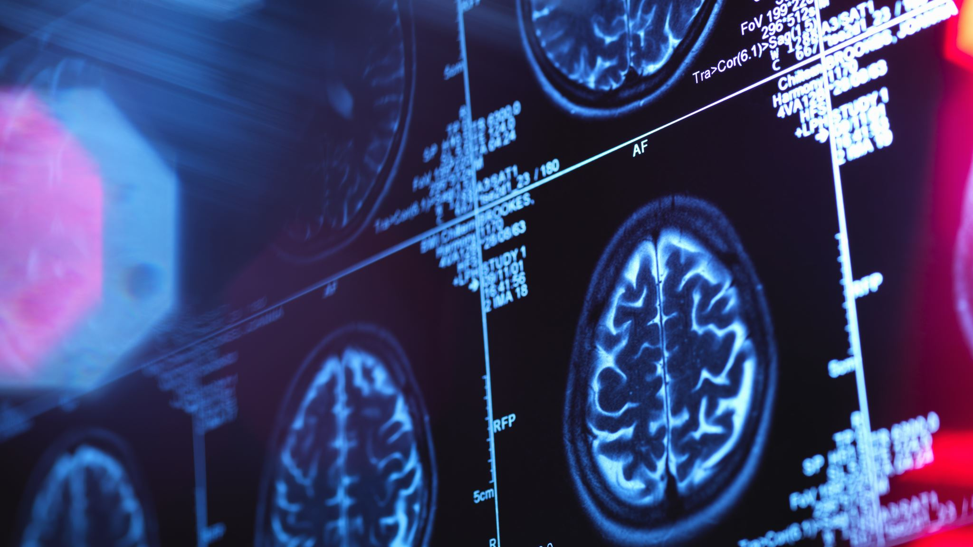
What is Abnormal Psychology?
Module 1 |

Slide 2
Learning Objectives
Explain what it means to display abnormal behavior.
Clarify the way mental health professionals classify mental disorders.
Describe the effect of stigma on those afflicted with mental illness.
Outline the history of mental illness.
Describe research methods used to study abnormal behavior and mental illness.
Identify types of mental health professionals, societies they may join, and journals they can publish their work in.

Slide 3
An Overview of Abnormal Psychology
Late 1800s
Focused on curing mental disorders
Involved psychologists: Freud, Adler, Klein, Jung, Erickson
1930s
Behaviorism – human behavior was thought to be modifiable if the correct combination of reinforcements and punishments were used
Mid 1900s
Increased examination of nature and nurture
Focused on making “miserable people less miserable” but failed to account for patients’ responsibility, to improve “normal” lives, and to create early interventions
Psychoanalytic theory/school of thought
Involved psychologists: B.F. Skinner
Mechanism – the world was thought to be a large machine that obeyed the laws of physics and chemistry; humans were simply smaller machines

Slide 4
An Overview of Abnormal Psychology
Humanistic psychology
1996
1960s
Involved psychologists: Abraham Maslow and Carl Rogers
Focused qualitatively on the full range of human functioning and on personal fulfillment; valued feelings over intellect, hedonism, emphasis on the present, a hierarchy of needs, etc.
Positive psychology
Involved psychologists: Martin Seligman
Focused quantitatively on happiness, love, hope, etc. and how to make the most out of setbacks

Slide 5
What is abnormal behavior?
Abnormal behavior is a combination of personal distress, psychological dysfunction, deviance from social norms, dangerousness to self and others, and costliness to society. According to the Diagnostic and Statistical Manual of Mental Disorders, 5th edition (DSM-5) however, there is “no definition that can capture all aspects of all disorders”.

Slide 6
Definitions and Clarifications
Dysfunction
Distress
Deviance
Dangerousness (not including the in DSM-5)
Behavior that represents a threat to the safety of the person or others
Still, a mental health professional has a duty to report to law enforcement when a mentally disordered individual expresses their intent to harm another person or themselves
“clinically significant disturbance in an individual’s cognition, emotional regulation, or behavior that reflects a dysfunction in the psychological, biological, or developmental processes underlying mental functioning” (pg. 20)
When an individual experiences a physically and/or mentally disabling condition “in social, occupational, or other important activities” (pg. 20)
Behavior that strays from what is culturally considered “normal” (i.e., social norms) although these norms themselves depend on time and place
HAVING A MENTAL DISORDER DOES NOT MEAN YOU ARE AUTOMATICALLY DANGEROUS OR VICE VERSA.

Slide 7
What’s the cost?
Depression is the number one cause of disability worldwide (National Alliance on Mental Illness)
Serious mental illness costs the US about $193 billion in lost earnings each year
Suicide is the 10th leading cause of death in the US and 90% of those who commit suicide have an underlying mental illness
37% of students age 14+ with a mental disorder will drop out of school
70% of youth in the justice system have at least one mental disorder
Mental illness cost us globally about $2.5 trillion in 2010; by 2030, this number is estimated to be $6 trillion

Slide 8
More Definitions
Abnormal psychology: the scientific study of abnormal behavior with the intent to be able to reliably predict, explain, diagnose, identify the causes of, and treat maladaptive behavior
Psychopathology: the scientific study of psychological disorders
Mental disorders: characterized by psychological dysfunction which causes physical and/or psychological distress or impaired functioning and is not an expected behavior according to societal or cultural standards

Slide 9
Classifying Mental Disorders
Epidemiology → the scientific study of the frequency and causes of diseases and other health-related states in specific populations such as school, neighborhood, a city, country, and the world
Presenting problem → what causes a patient to seek help
Clinical description → information about the thoughts, feelings, and behaviors demonstrated in a mental disorder; can also include information about the occurrence of the disorder, its cause, course, and treatment possibilities

Slide 10
Measuring Occurrence: Incidence VS Prevalence
Incidence
Prevalence
The number of NEW cases in a population over a specific period of time
Usually this value is lower than the prevalence because it doesn’t include existing cases
The percentage of people in a population that has a mental disorder
Point prevalence → the proportion of a population that has the characteristic at a SPECIFIC POINT IN TIME
Period prevalence → the proportion of a population that has the characteristic AT ANY POINT during a given period of time
Lifetime prevalence → the proportion of a population that has had the characteristic at ANY TIME IN THEIR LIVES

Slide 11
More Definitions
Comorbidity → when two or more mental disorders are occurring at the same time and in the same person
It was found that 45% of those with one mental disorder met the criteria for two or more disorders (i.e., 45% of those with mental disorders experience comorbidity)
Comorbidity is strongly related to how disabling a mental illness is
Substance use disorders often result from disorders like anxiety and bipolar mood disorders
Etiology → the cause of the disorder; this can be social, biological, and/or psychological
Course → the pattern of the disorder
Acute: the disorder lasts a short period of time
Chronic: the disorder lasts a long period of time
Time-limited: recovery will occur in a short period of time regardless of whether any treatment occurs
Prognosis → the anticipated course the mental disorder will take; depends on the disorder, the patient’s age, etc.
Treatment → any procedure intended to modify abnormal behavior into normal behavior

Slide 12
Stigma: Why People Don’t Seek Help
Social cognition → the process through which we collect information from the world around us and then interpret it
Sensation: detection of physical energy using our eyes, ears, nose, skin, and mouth
Perception: the application of meaning to what we sense
We often place people into CATEGORIES.
In each category, there is a SCHEMA.
Schema: a set of beliefs and expectations about a group of people
Stereotypes: special types of schemas that are very simplistic, very strongly help, and not based on firsthand experience; aka heuristics (mental shortcuts)
What if an individual doesn’t belong to a category or a schema doesn’t apply to them anymore?
Our first impressions (aka the primacy effect) is super strong! It is unlikely to change. This lack of flexibility is called the perseverance effect or belief perseverance.

Slide 13
Social Identity Theory
States that people categorize their social world into meaningfully simplistic representations of groups of people
Basically, we create in-groups and out-groups which can be problematic…
Out-group homogeneity → when one views all members of a group outside the immediate group as the same
In-group/out-group bias → from out-group homogeneity comes favoritism towards those in-group and exclusion of those out-group
Prejudice → a negative view or set of beliefs about a group of people
Discrimination → the negative behavior against out-group members that often stems from prejudice
Implicit attitude → an attitude that we may have but are unaware of
Explicit attitude → an attitude which we publicly state we have

Slide 14
Types of Stigma
Public stigma → when members of a society endorse negative stereotypes of people with a mental disorder and discriminate against them (e.g., when an employer chooses not to hire someone because they have a mental illness)
Label avoidance → to avoid being called “crazy”, a person who needs help may avoid seeking that care
Self-stigma → when people with mental illnesses internalize the negative stereotypes and prejudice and then discriminate against themselves (e.g., feelings of shame, reduced self-esteem, etc.)
Courtesy stigma → when stigma affects people associated with the person with a mental disorder (e.g., family members)

Slide 15
Why does stigma matter?
Stigma can lead to…
Work-related discrimination
Higher rates of suicide
Decrease likelihood of seeking help
Increase in social distance

Slide 16
What can be done to decrease stigma?
Education
Presenting mental illness as something that’s treatable
Increasing patients’ hope for recovery
Legislation (e.g., Patient Protection and Affordable Care Act of 2010, Mental Health Parity and Addiction Equity Act of 2008, Americans with Disabilities Act of 1990)

Slide 17
The History: Prehistoric and Ancient Beliefs
Prehistoric cultures often held a supernatural view of abnormal behavior; they thought mental illness was the work of evil spirits, demons, gods, witches, etc.
Treatments
Trephination → a process in which a stone implement is used to remove a part of the skull so as to allow evil spirits to escape
Exorcism → the casting out of evil spirits through prayer, magic, flogging, etc.

Slide 18
The History: Greco-Roman Thought
Thought that mental illness was like physical illness and that mental illness came from brain pathology (i.e., trauma or disease of the brain) and heredity
Hippocrates
He suggested three categories for mental illnesses: melancholia, mania, and phrenitis (brain fever)
He also explained that four humors (fluids) directed normal brain functioning and personality: blood from the heart, black bile from the spleen, yellow bile/choler from the liver, and phlegm from the brain. If these humors were imbalanced, a mental illness would arise.
Plato
Argued that mentally ill individuals should not be punished
Other important physicians: Galen, Asclepiades, Cicero
Treatments:
“contrariis contrarius” (opposite by opposite) → involved contrasting stimuli to regain balance

Slide 19
The History: The Middle Ages (500-1500 AD)
Mental illness was once again thought to be caused by demonic possession and was treated through religious ceremonies (e.g., exorcism).
In some extreme cases, the mentally ill would be confined, beaten, or even executed.
Mass madness → aka group hysteria, occurred when large numbers of people displayed similar symptoms and false beliefs (e.g., that they were possessed by wolves or that they had to dance)

Slide 20
The History: The Renaissance (1500-1700s)
Humanism → the worldview that emphasizes human welfare and the uniqueness of the individual
Asylums → places of refuge for the mentally ill
Became popular in the 16th century
Benign at the beginning
But soon, with population overflow in these asylums, a standard of treatment was forgotten (e.g., Bethlem Hospital, London)

Slide 21
The History: Reform Movement (1700-1800s)
Moral treatment movement → gave the mentally ill respect, moral guidance, and humane treatment, all while considering their individual, social, and occupational needs
This movement’s success was responsible for its decline (e.g., staffing shortages, lack of funds, increasing asylum populations, etc.)
Another reason that the humane treatment was short-lived was because of the mental hygiene movement, which focused on the physical well-being of the patient
Important figures:
Francis Pinel → improved conditions in Parisian asylums
William Tuke → created the York Retreat and inspired the Country Asylums Act of 1845 which required every English county to provide asylum to the mentally ill
Benjamin Rush → advocated for humane treatment of the mentally ill in the US although he still utilized bloodletting, purgatives, astrology, and the “tranquilizing chair”
Dorothea Dix → proponent of the mental hygiene movement in the United States

Slide 22
The History: The 20th-21st Centuries
Biological/Somatogenic Perspective
Psychological/Psychogenic Perspective
Emil Kraepelin discovered the symptoms occurred regularly in clusters which he called syndromes. His work led to the modern DSM.
A test and treatment for syphilis, which had psychological ramifications, were created.
Use of electric shock treatment
States that emotional or psychological factors are the cause of mental disorders
Most proof came from hypnotism:
Mesmer, animal magnetism and mesmerism
French physicians found that hysteria could be induced
Pierre Janet and the cathartic method

Slide 23
The History: Today
Results of the National Comorbidity Study (2001-2003)
46% of participants had a psychiatric disorder at some point in their lives
The most reported disorders were major depression, alcohol abuse, social anxiety disorder, and conduct disorder
Women were more likely to have an anxiety or mood disorder; men were more likely to have impulse control disorders
28% reported having a comorbid disorder
80% sought treatment, although sometimes this was a decade after symptoms emerged; only 33% were adequately treated
Women were more likely to seek help than men
Whites were more likely to seek help than African and Hispanic Americans
Increased reliance on psychiatric drugs (e.g., antidepressants, mood-stabilizers, antipsychotics, anti-anxiety drugs, etc.) which has led to deinstitutionalization (the release of patients from mental health facilities)
New prevention stance where we attempt to intervene in someone’s mental health before a problem arises

Slide 24
Multicultural Psychology
Multicultural psychology → an approach where one understands how various groups differ from one another to avoid bias, whether defined by race, culture, or gender
6 Guidelines
Psychologists may hold beliefs that can negatively influence their perceptions of and interactions with individuals who are different from themselves.
Psychologists should recognize the importance of multicultural sensitivity.
Psychologists should employ the constructs of multiculturalism in psychological education.
Researchers should recognize the importance of conducting culture-centered and ethical psychological research.
Psychologists strive to apply culturally-appropriate skills in clinical and other applied psychological practices.
Psychologists should use organizational change processes to support culturally informed organizational development and practices.

Slide 25
A Note on Managed Health Care
Managed health care refers to a type of health insurance in which the insurance company determines the cost of services, providers a person may see, and the number of visits a subscriber can have within a year.
Subscribers of managed health care do not pay out-of-pocket although they may have co-pays due.
Three types of managed health care:
Health Maintenance Organizations (HMO) → a subscriber chooses a primary care physician who then sends the subscriber to other providers
Preferred Provider Organizations (PPO) → if a subscriber seeks care from within network, the insurance will cover more of the costs
Point of Service (POS) → a subscriber gets to choose between an HMO and PPO each time care is needed

Slide 26
The Scientific Method A systematic method for gathering knowledge about the world around us
Ask questions and think critically
1
Identify a research question or problem to investigate (tip: start with a literature review to see where you can fill in the gaps of current knowledge!)
2
Attempt to explain the phenomena by creating a theory and/or a testable hypothesis
3
Test the hypothesis by performing a research design
4
Interpret the results using meaningful statistics)
5
Draw conclusions
6
Communicate the findings with a larger scientific community so that your experiment can be replicated
7

Slide 27
Research Methods
Naturalistic observation → where a scientist systematically studies human or animal behavior in its natural environment
Advantage: your results aren’t tainted by the experimenter
Disadvantage: the observation may take a long time and/or your presence may influence those being observed
Laboratory observation → where people or animals are observed in a lab setting
Advantage: you can use sophisticated equipment
Disadvantage: your presence could influence those being observed
Case studies → a detailed description of one person or of a small group based on careful observation
Advantage: you create a detailed description of the behavior
Disadvantage: you may not be able to generalize your results to a larger population

Slide 28
Research Methods, cont.
Surveys/self-reports → involves a questionnaire which assesses a psychological construct of interest
Advantage: you can get many responses quickly
Disadvantage: the participants may find the survey tedious or fall victim to social desirability, which means that they respond dishonestly so that their answers are seen favorably
Correlational research → investigates the strength of a relationship between two variables using a correlation coefficient (-1.00 to +1.00)
Advantage: you can correlate anything
Disadvantage: you can correlate anything
Experiments → controlled tests that study cause and effect relationships

Slide 29
Types of Professionals
Clinical psychologists → trained to make diagnoses and can provide individual and group therapy; they can prescribe medications in select states
School psychologists → trained to make diagnoses and can provide individual and group therapy but also works with school staff
Counseling psychologists → deals with adjustment issues primarily and less with mental illness
Clinical social workers → trained to make diagnoses and can provide individual and group therapy and is involved in advocacy and case management, usually in hospital settings
Psychiatrists → has specialize training in the diagnosis and treatment of mental disorders and can prescribe medications
Other professions include psychiatric nurse practitioners, occupational therapists, pastoral counselors, drug abuse and/or alcohol counselors, child/adolescent psychiatrists, marital and family therapists, etc.

